Slide 1
EP-010040 Session 11, 8:00-9:30, Order 4, Station 1, 8:15-, July 12
Measuring workplace climate: Reliability and validity of the 20-item Organization Climate Scale
Takayo Inoue(Meiji Gakuin University), Yutaka Toshima(Nihon University),
*Takehiko Ito (Wako University: take@wako.ac.jp)
[Background] The National Institute for Occupational Safety and Health (NIOSH）points out three major characteristics of organization: management practice, organizational culture/climate, and organizational values. They have effects on organizational health consisting of health/satisfaction outcome and performance outcome. They constitute the model of healthy work organizations satisfying both company performance and well-being of employees. Fukui, Haratani, Toshima, Shima et al.（2004）developed Organization Climate Scale (OCS).
[Purpose]
The present study develops and investigates validity and internal consistency of the two subscales of 20-item OCS with Tradition Subscale (TS) and Organizational Environment Factor (OES), each with 10 items (See Table 1).
[Method]
In a private company in Japan, 103 employees answered questionnaire with 20-item OCS , occupational stress items by the Job Satisfaction Scale, the Motivator Morale Scale, and mental health items by GHQ-12.

Slide 2
[Results]
Internal reliability
As shown in Fig. 1 in next page, items of TS (left) and OES (right) were separated in terms of similarity of overall responses. Alpha coefficient of each subscales were high enough.
(2) External validity
According to multiple regression analysis, OES significantly related to Job Satisfaction Scale (β = .557) and Motivator Morale Scale (β =.546), while TS significantly explained GHQ-12 (β = .405) .
[Discussion]
(1)Tradition Subscale and Organizational Environment Subscale were independent and worked differently towards the external indices.
(2) Tradition factor of organizational climates is important for mental health of employees.
(3) Organizational environment climate strongly relates to workers’ satisfaction and motivation .

Slide 3
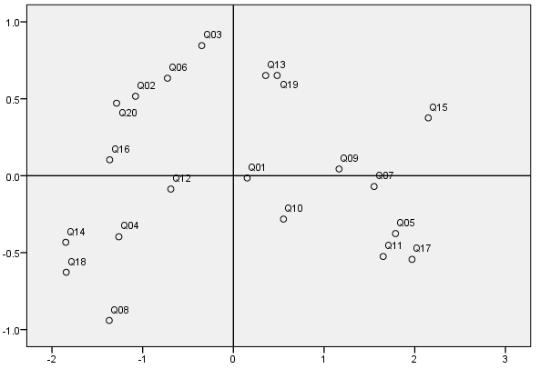
Table 1. 20 items of Organizational Climate Scale
[Tradition Factor (TS)]
2 It is strictly required that employees are to follow the company policy and regulations.
4 Managers reproach but seldom give credit.
6 Employees are likely to be spoken of badly unless they do their job right away.
8 There is a tendency for the company to neglect the existence of the individual.
10 Managers tend to keep a close eye on subordinates all the time.
12 Most employees regard the tradition and customs of their company as strictly enforced.
14 Employees are able to tell their opinions to managers without hesitation. ( - )
16 Employees are allowed to work as they like. ( - )
18 Managers are trying to fit in their subordinates for themselves. ( - )
20 Employees are always feeling under pressure at work.
[Organizational Environment Factor (OES)]
1 Employees seem to have the attitude of playing their part by all means.
3 Employees are working very hard.
5 Employees are told what they have to do during the day in detail.
7 Topics of a meeting are well arranged and cover the general range.
9 The attention and guidance by middle class managers go into details.
11 The results of the meetings are used to advantage for the next tasks.
13 Each employee has his/her own important responsibility.
15 Managers are trying to give their subordinates a fair deal <- tradition organizational
17 Attending work is very interesting. environment->
19 There are few people to be willing to work voluntarily in the company. ( - ) Fig 1. Item similarity ( MDS)

